Slide 1
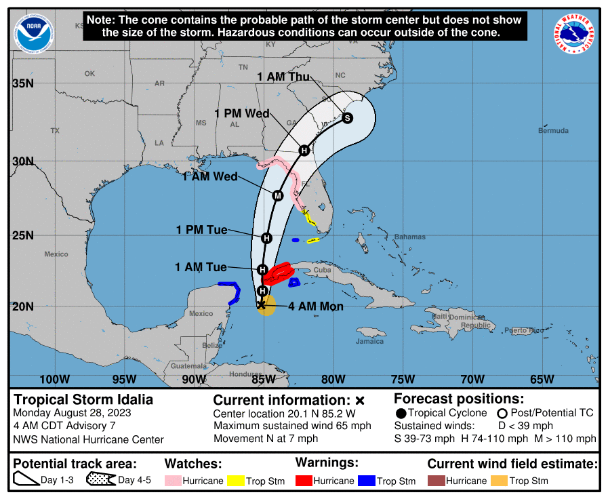
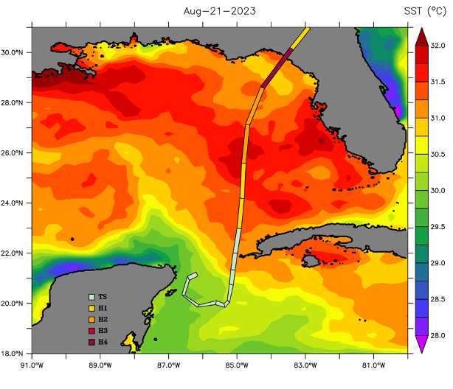
Observations and Forecasts of Hurricane Interactions with the Loop Current: Hurricane Idalia
NASEM GRP UGOS WG-C
NOAA/Navy Hurricane Glider Team
IOOS Hurricane Model/Data Comparison Team
Scott Glenn, Travis Miles, Michael Smith, Julia Engdahl, Tim Stolarz, Tony Knap, Steve DiMarco, Andy Dancer, Sakib Mahmud, Uchenna Nwankwo, David Salas de Leon, Rosalinda Monreal Jimenez, Edgar Escalante Mancera, Miguel Angel Gomez Reali, Pelle Robbins, Heather Furey, Amy Bower, Miguel Tenreiro, Enric Pallas Sanz, Rafael Ramos, Bruce Magnell, Jill Storie, Samantha Longridge, Anneliese Schmidt, Ben Jaimes de la Cruz, Nick Shay, Pierre Lermusiaux, Patrick Haley, Chris Marabito, Paula Perez Brunius, Nathali Cordero Quiros, Bruce Cornelle, Stephan Howden, Alexandra Bozec, Ganesh Gopal, Matthieu LeHenaff, Hyun-Sook Kim, Pat Hogan, Jan van Smirren, Kathy Bailey, Bill Lingsh, Corbin Brooks, Doug Wilson, Catherine Edwards, Julio Morell, Jorge Brenner, Kevin Martin, Chad Lembke, Natalia Sidorovskaia, Yonggang Liu, Bob Weisberg, Bob Currier, Dawn Petraitus, Kevin O’Brien, Avichal Mehra, Zulema Garraffo, Dmitry Dukhovskoy, Maria Aristizabal, Dan Iredell, Jim Cummings (60)

Slide 2
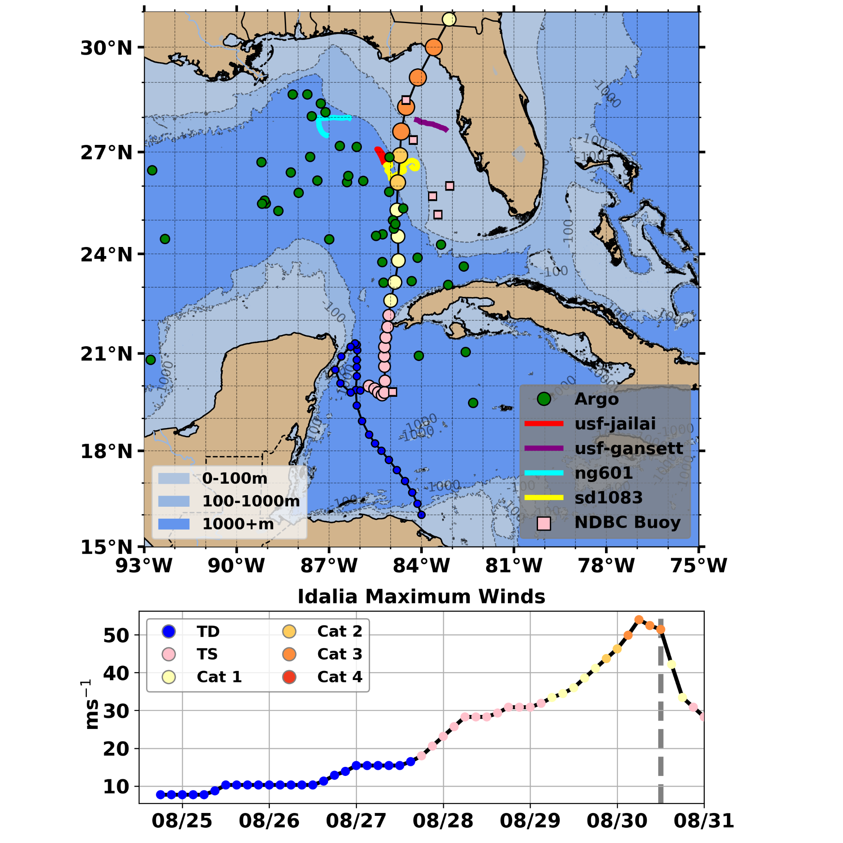
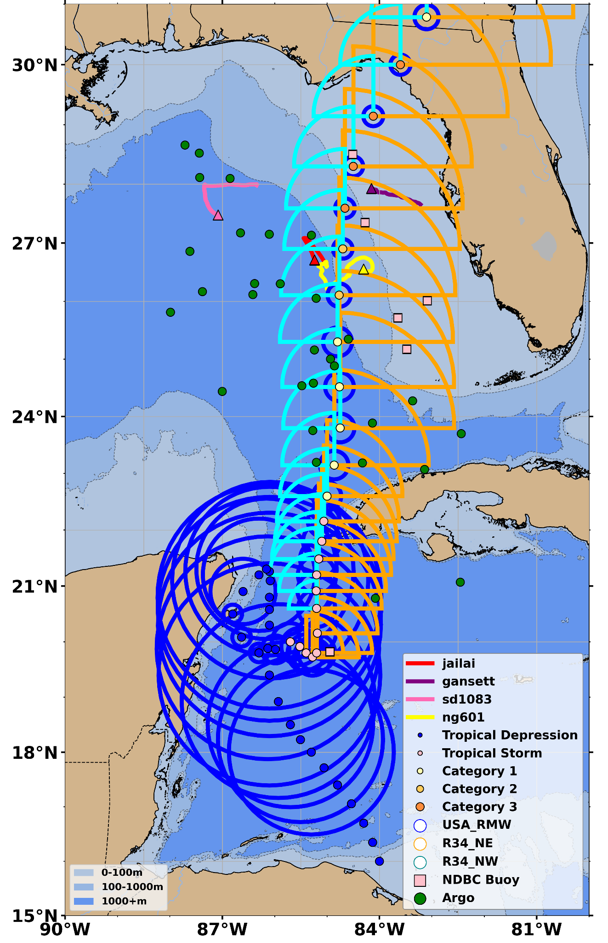
Hurricane Idalia - Cat 1 off Cuba to Cat 3 Landfall in 2 Days
Stage 3: Rapid Intensification to Cat 3 along the West Florida Shelf & the Hurricane Gliders and Saildrone, IOOS HFR
Stage 2: Intensification to Cat 1 Hurricane over the Loop Current & the UGOS Argo floats
Stage 1: Formation over the Yucatan Strait & the Yucatan HFRs

Slide 3
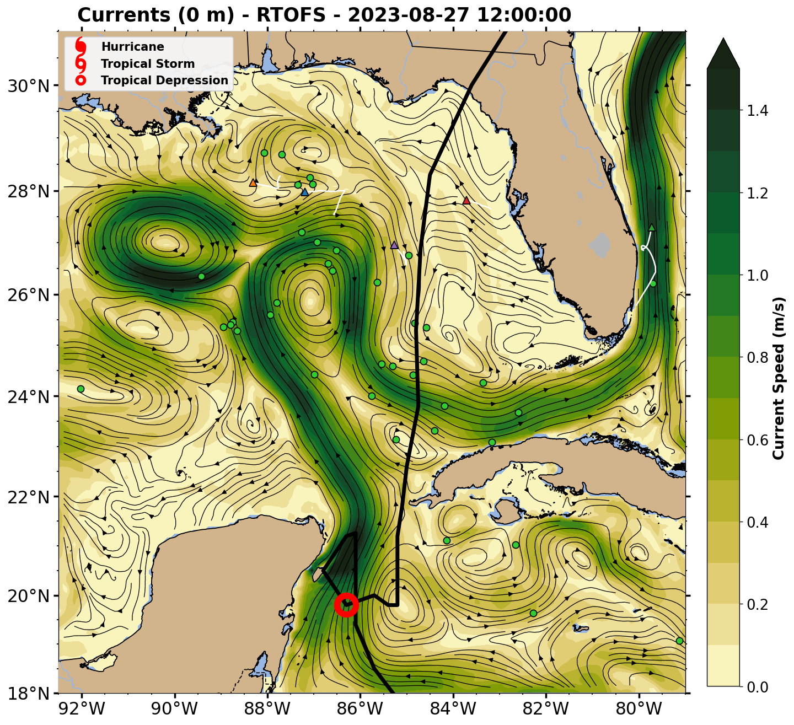
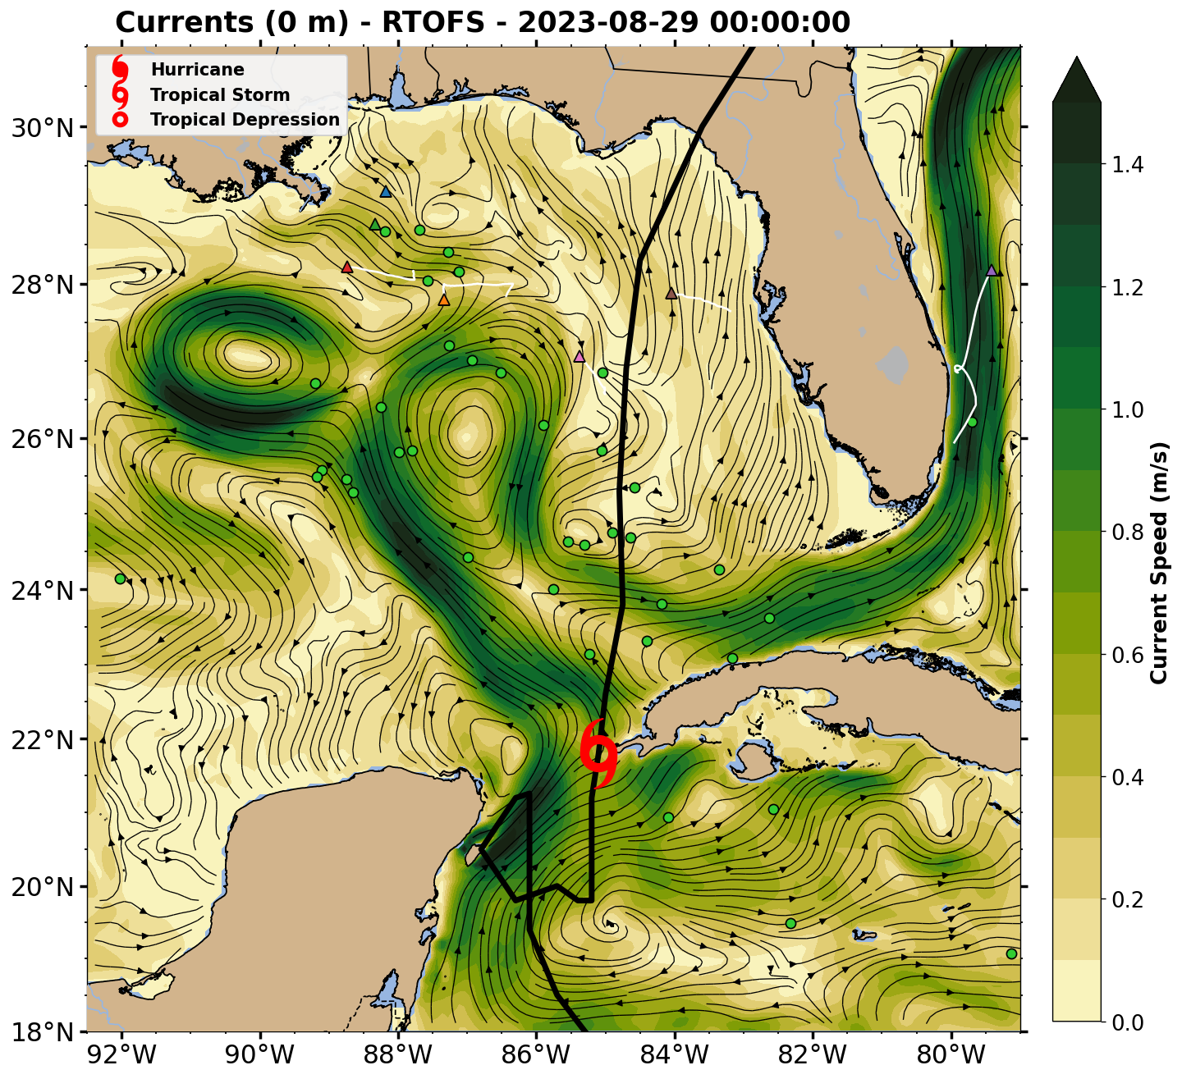
Tropical Storm Idalia - Stage 1 - Formation
Surface Currents - NOAA global Real Time Ocean Forecast System (RTOFS)

Slide 4
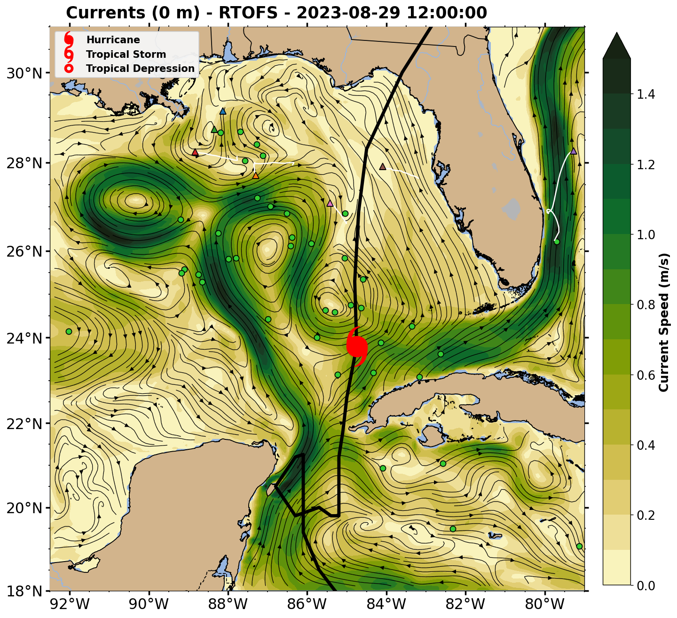
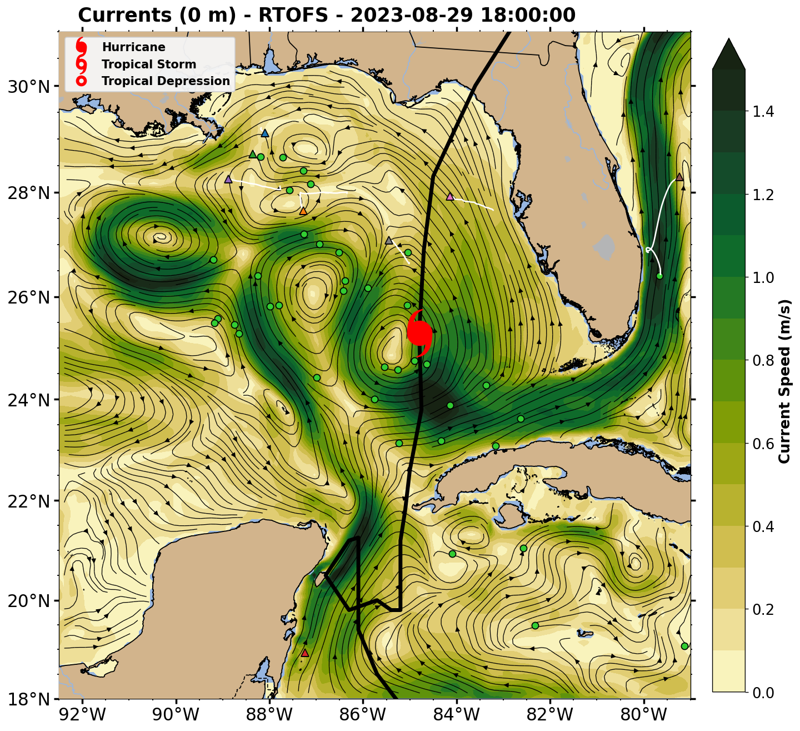
Hurricane Idalia - Stage 2 - Intensification to Cat 1
Surface Currents - NOAA global Real Time Ocean Forecast System (RTOFS)

Slide 5
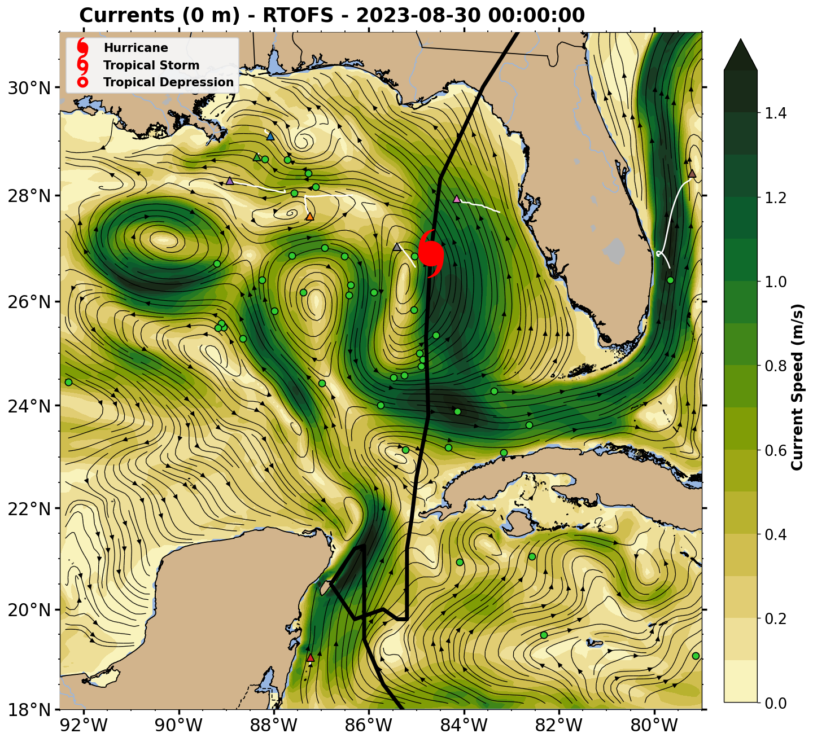
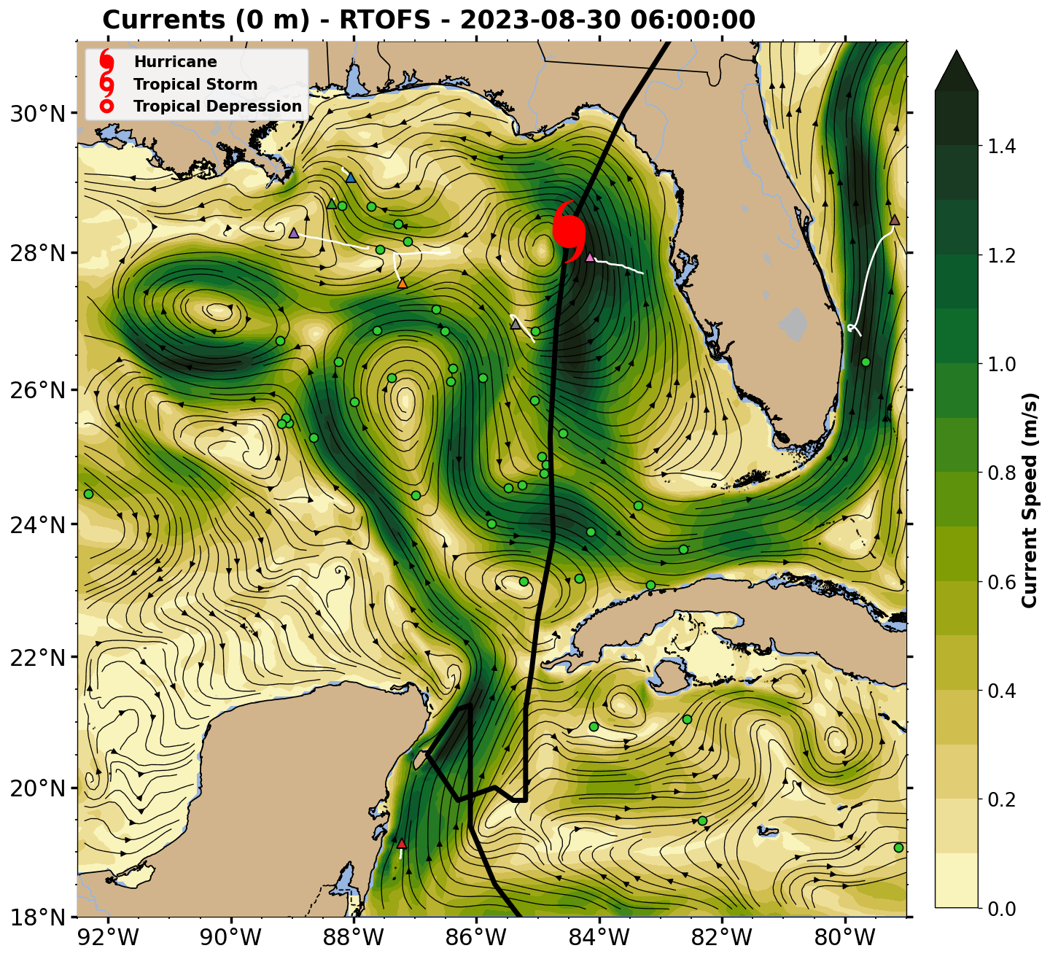
Hurricane Idalia - Stage 3 - Rapid Intensification to Cat 3
Surface Currents - NOAA global Real Time Ocean Forecast System (RTOFS)

Slide 6
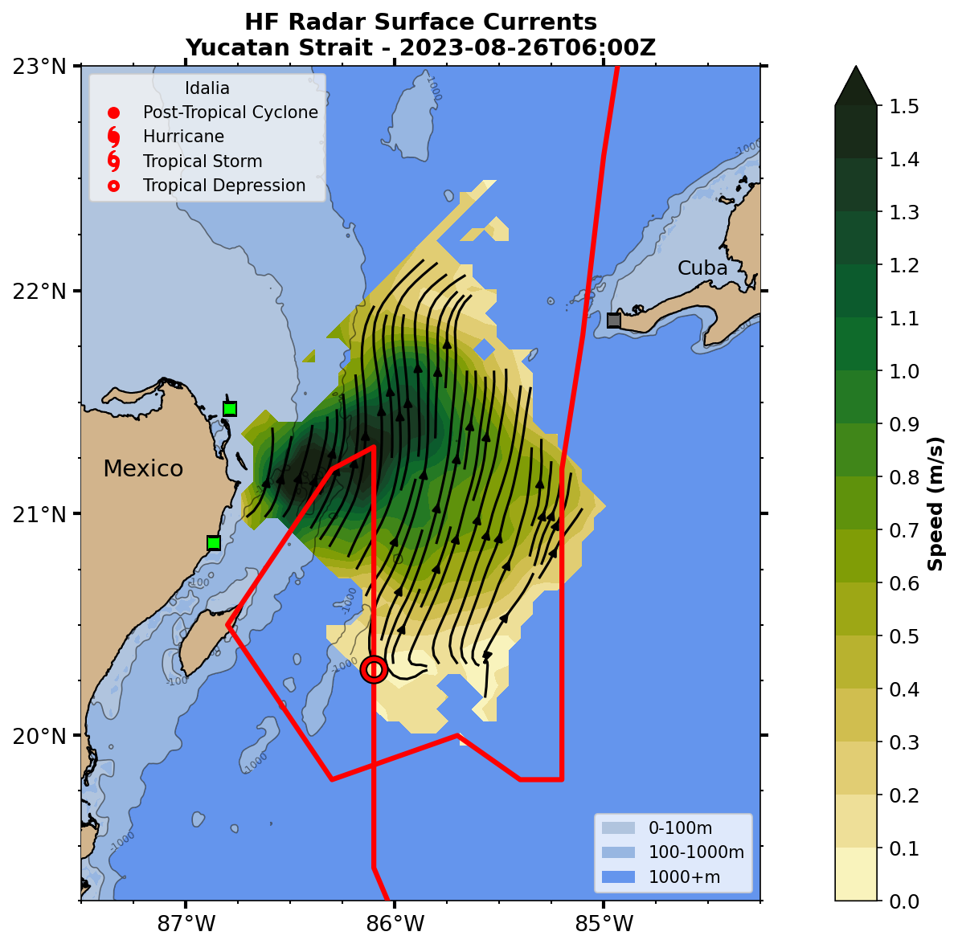
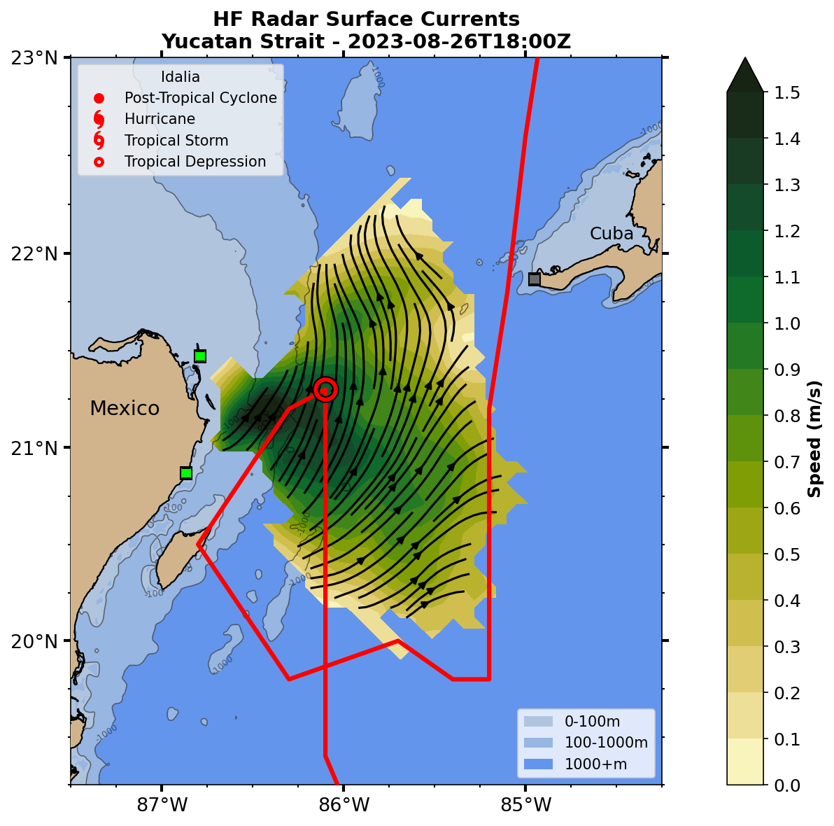
Hurricane Idalia - Stage 1 - First Pass
Yucatan HF Radar (HFR) Hourly Surface Current Maps

Slide 7
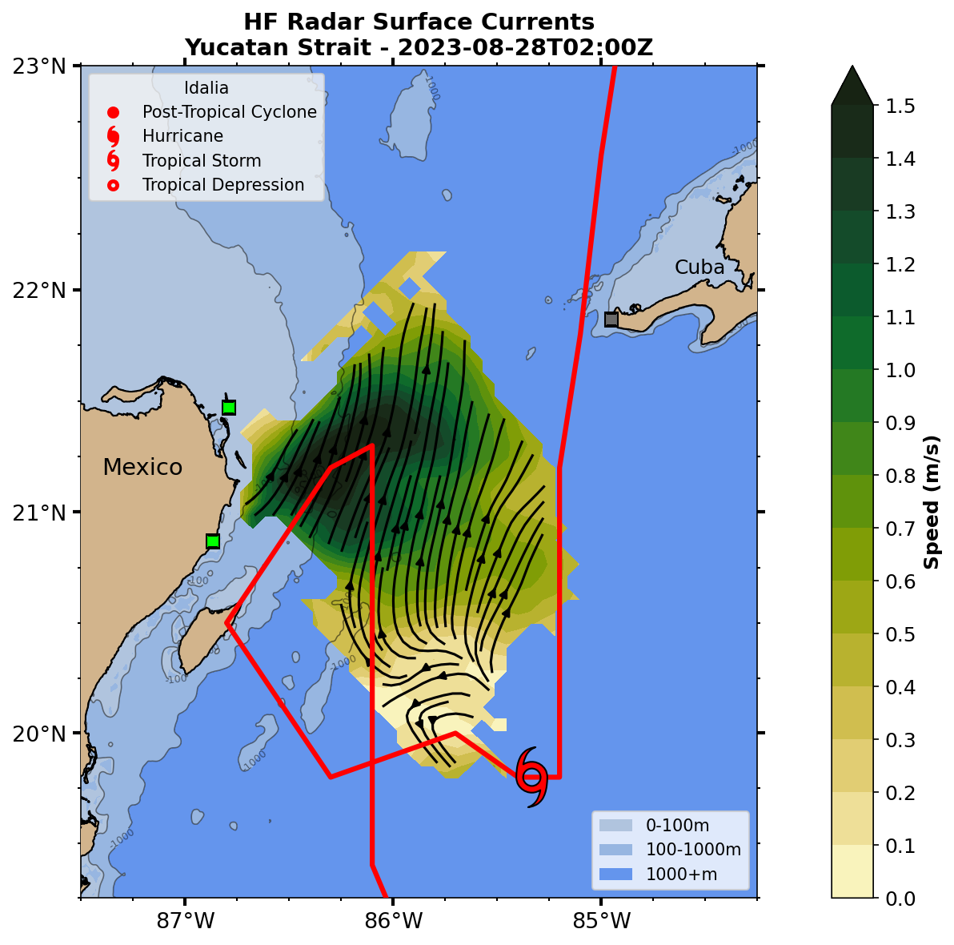
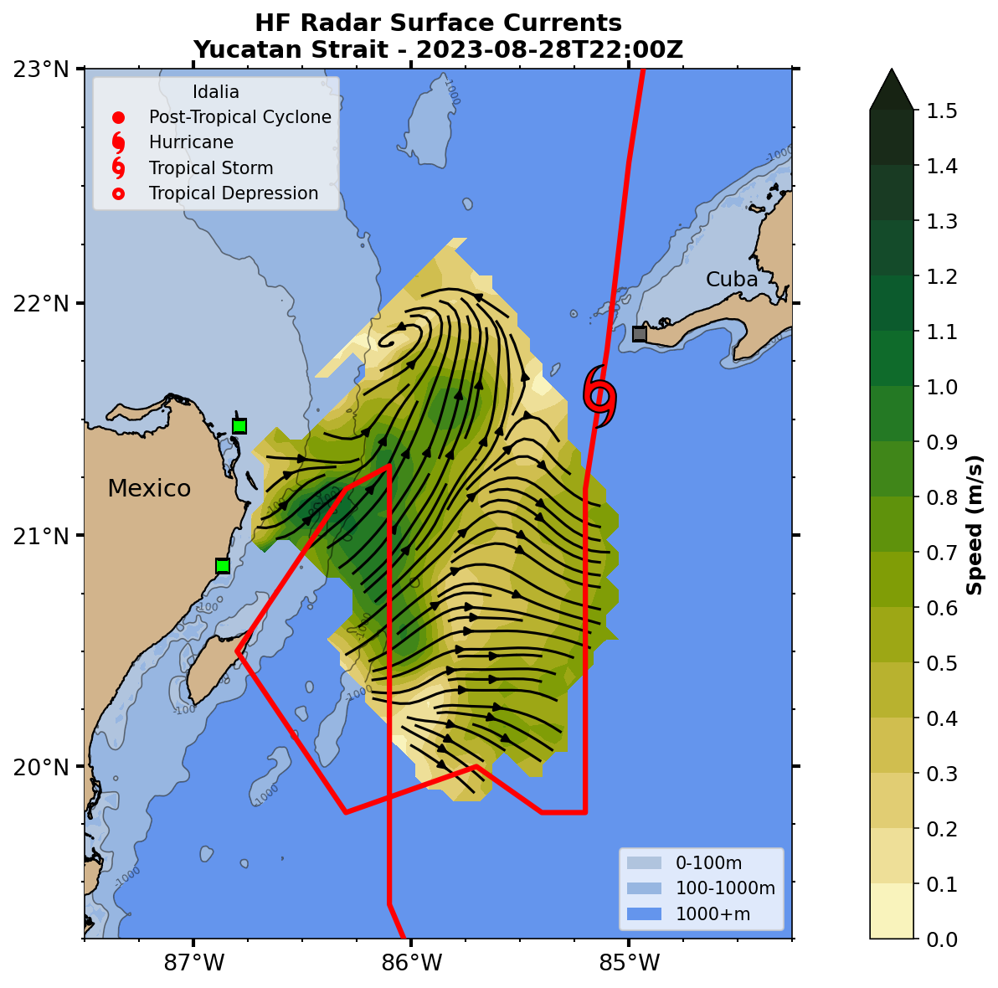
Hurricane Idalia - Stage 1 - Second Pass
Yucatan HF Radar (HFR) Hourly Surface Current Maps

Slide 8
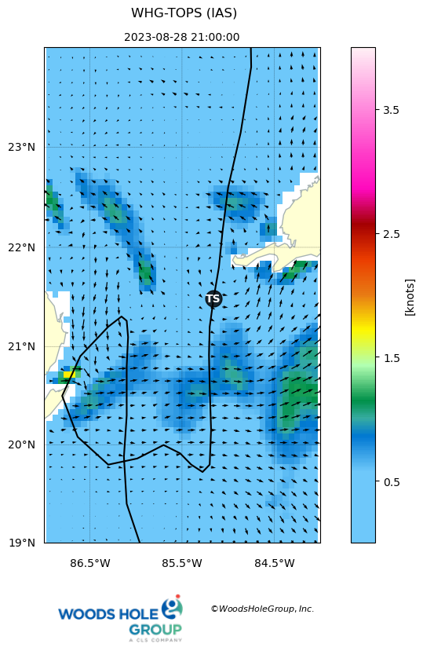
Hurricane Idalia - Stage 1 - Second Pass
WHG TOPS Model Surface Currents (Left) - Difference from the Background
Model Background here is the average of 1 week before and 1 week after the storm

Slide 9
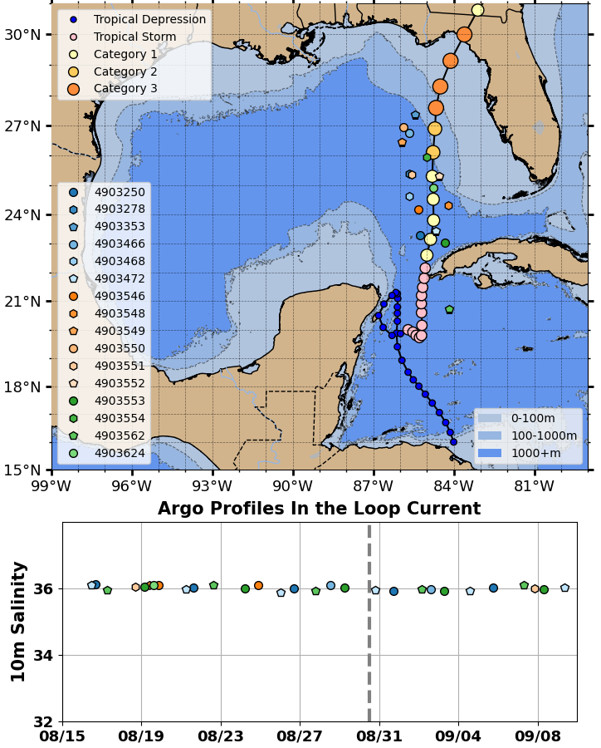
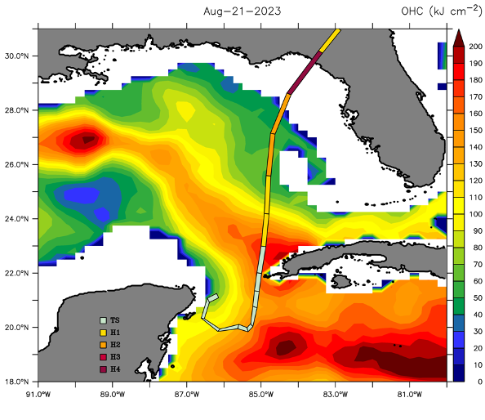
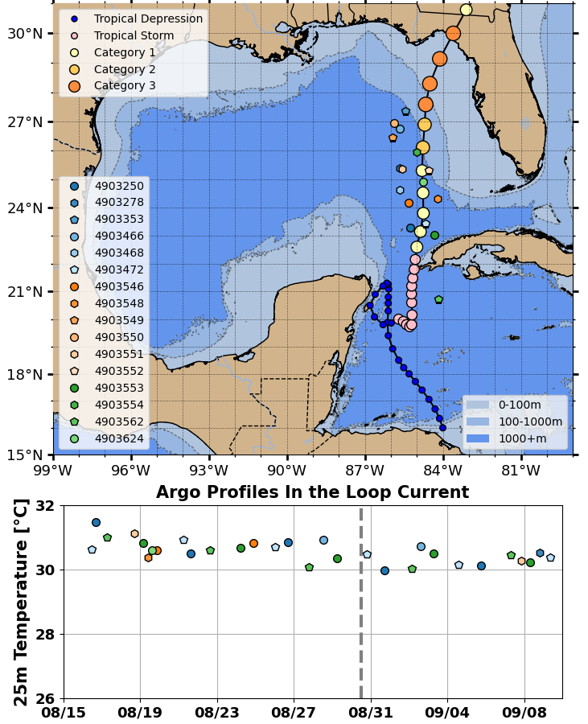
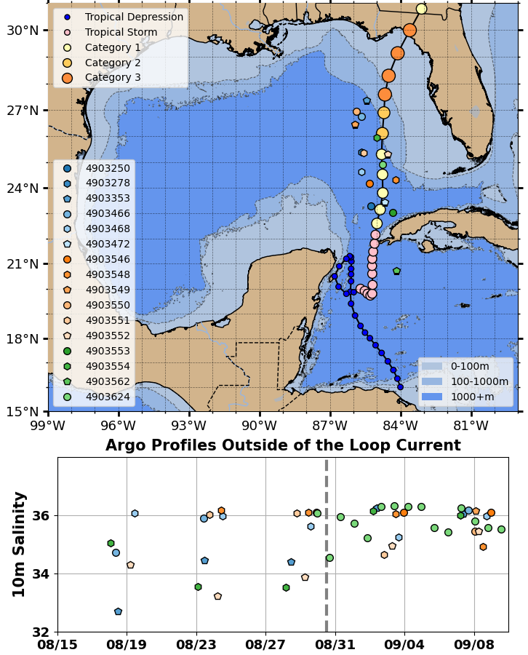
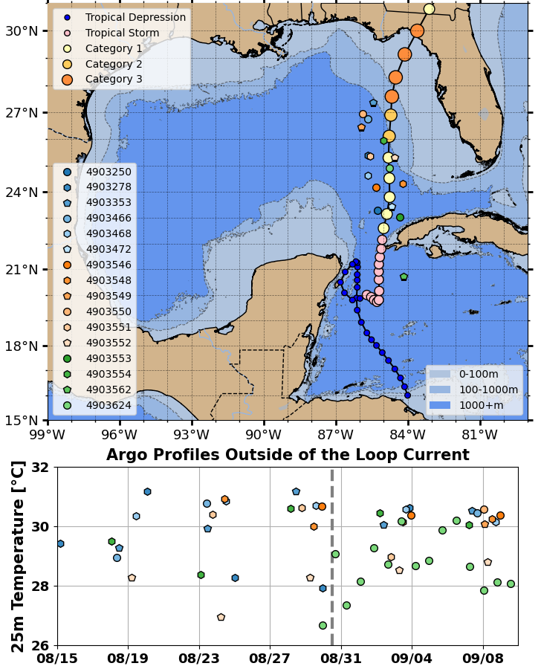
Hurricane Idalia - Stage 2
Argo Float Near-Surface Temperature - In (bottom left) & Out (bottom right) Loop Current
UMiami / NOAA NESDIS Ocean Heat Content product

Slide 10
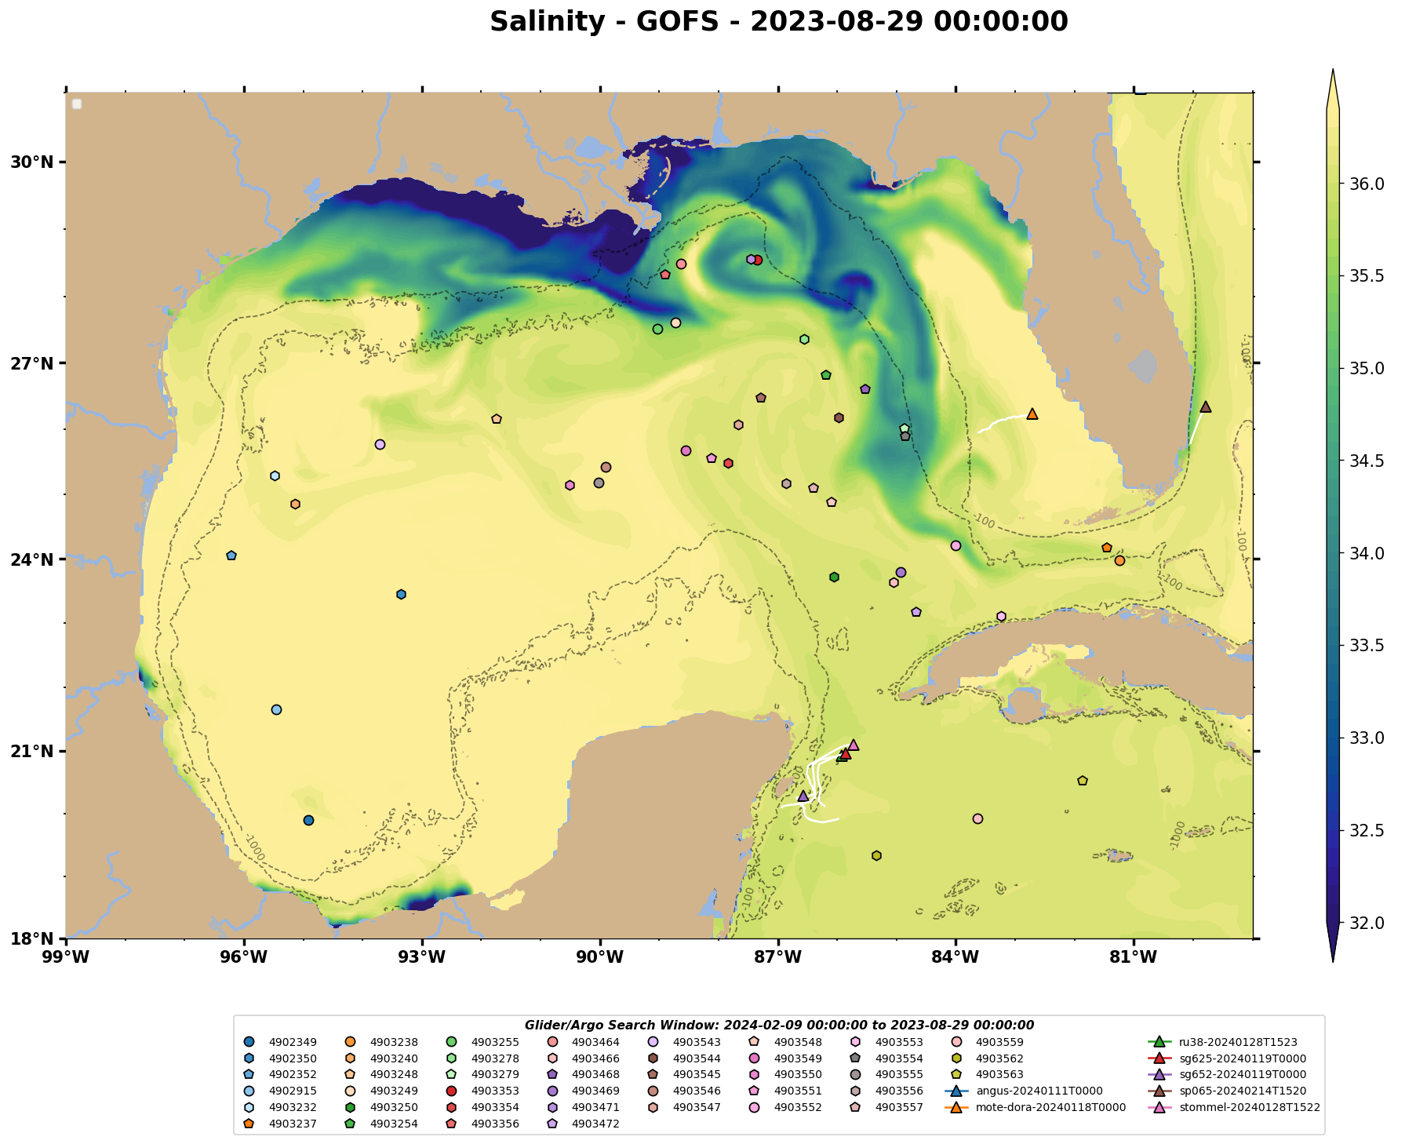
Hurricane Idalia - Stage 2
Argo Float Near-Surface Salinity - In (bottom left) & Out (bottom right) Loop Current
Navy Global Ocean Forecast System (GOFS)
Surface Salinity

Slide 11
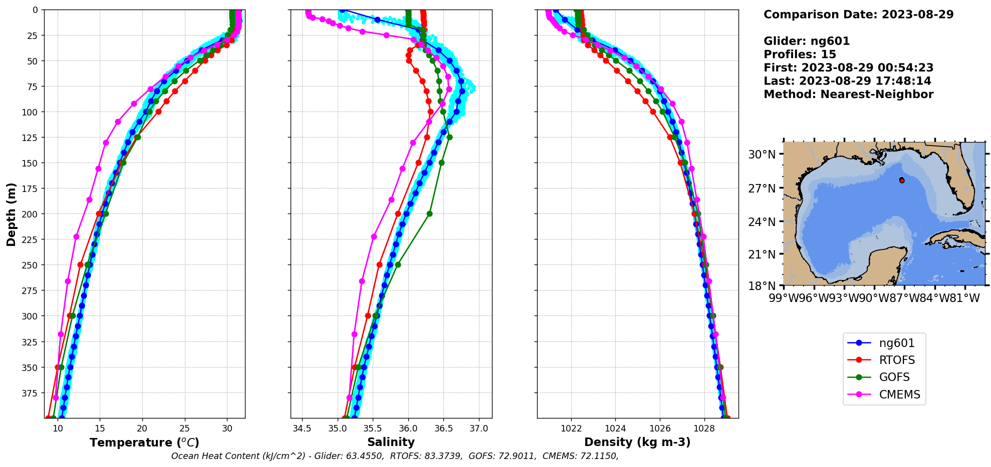
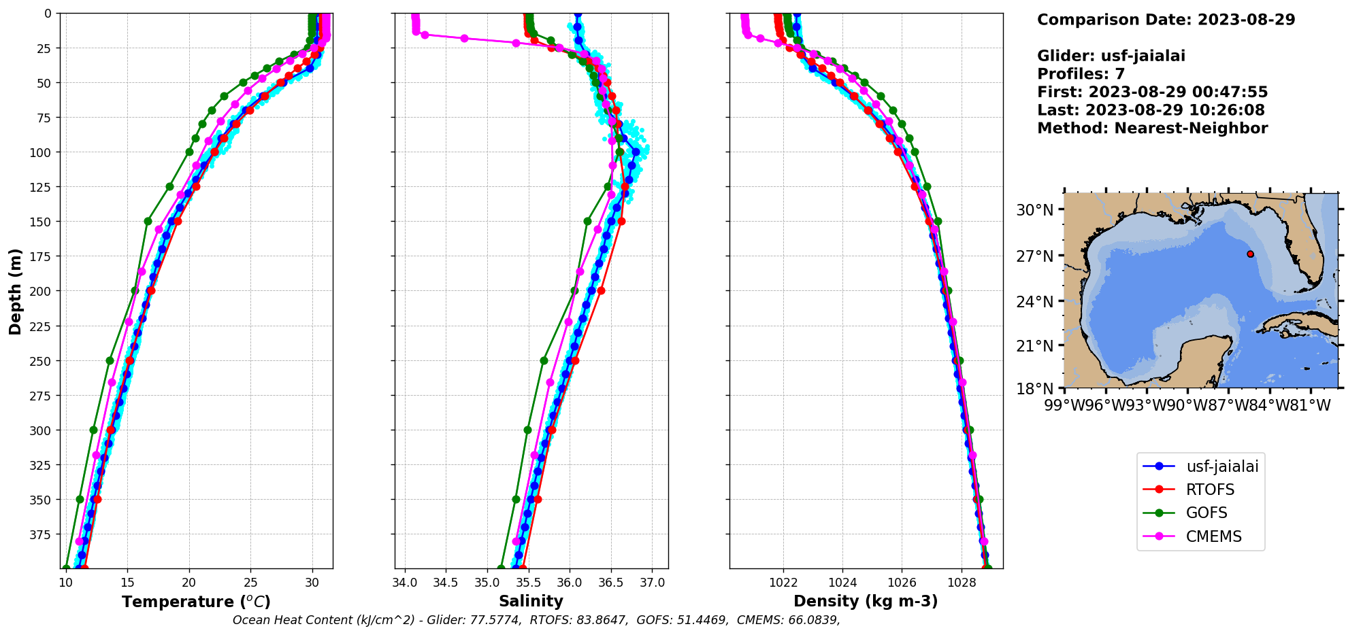
Hurricane Idalia - Stage 2 - Operational Models /
Glider Data comparisons before Assimilation
Hurricane Gliders
NOAA RTOFS
Navy GOFS
European CMEMS
Upstream
Navy
Glider
NG601
Glider profiles are assimilated daily
Larger corrections made by upstream gliders are advected towards downstream gliders that make smaller corrections
Downstream
USF
Glider
Jaialai

Slide 12
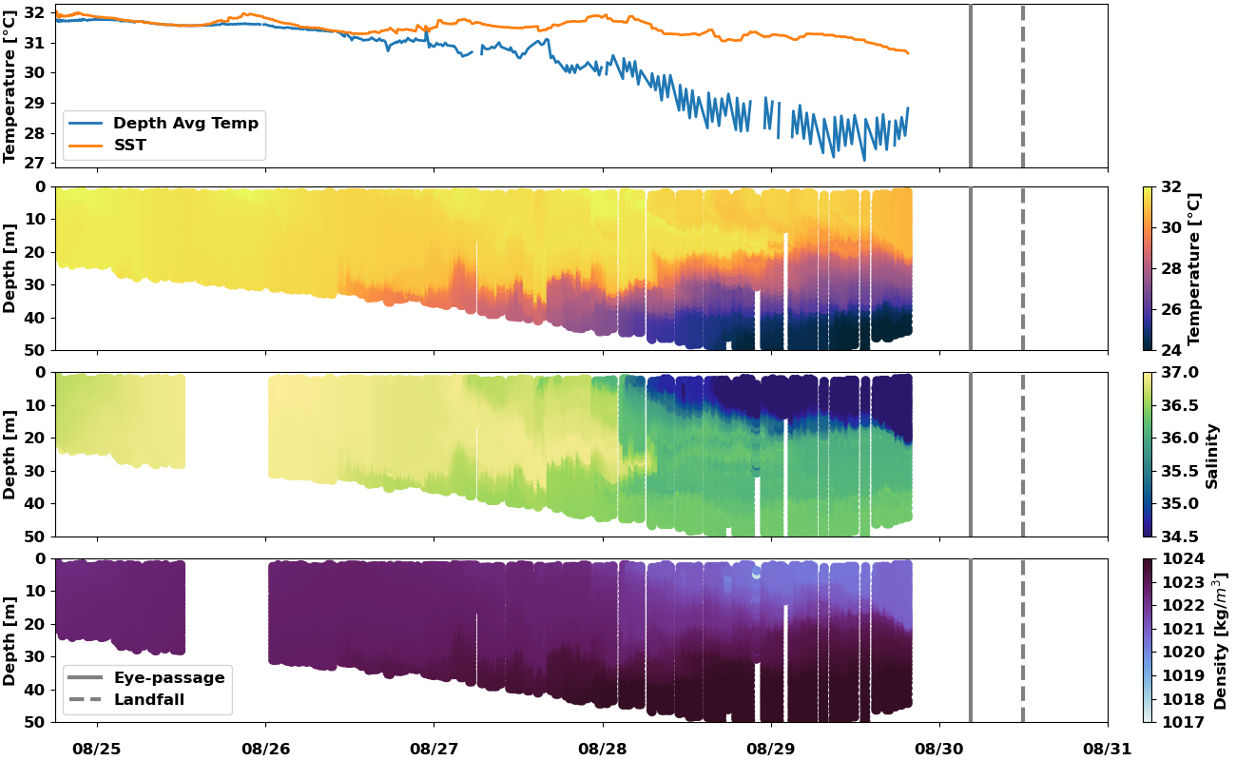
Hurricane Idalia - Stage 3
USF Slocum Glider Gansett on the West Florida Shelf
USF Glider
Navy Glider
HAFS Model
Temperature
Salinity
Density

Slide 13
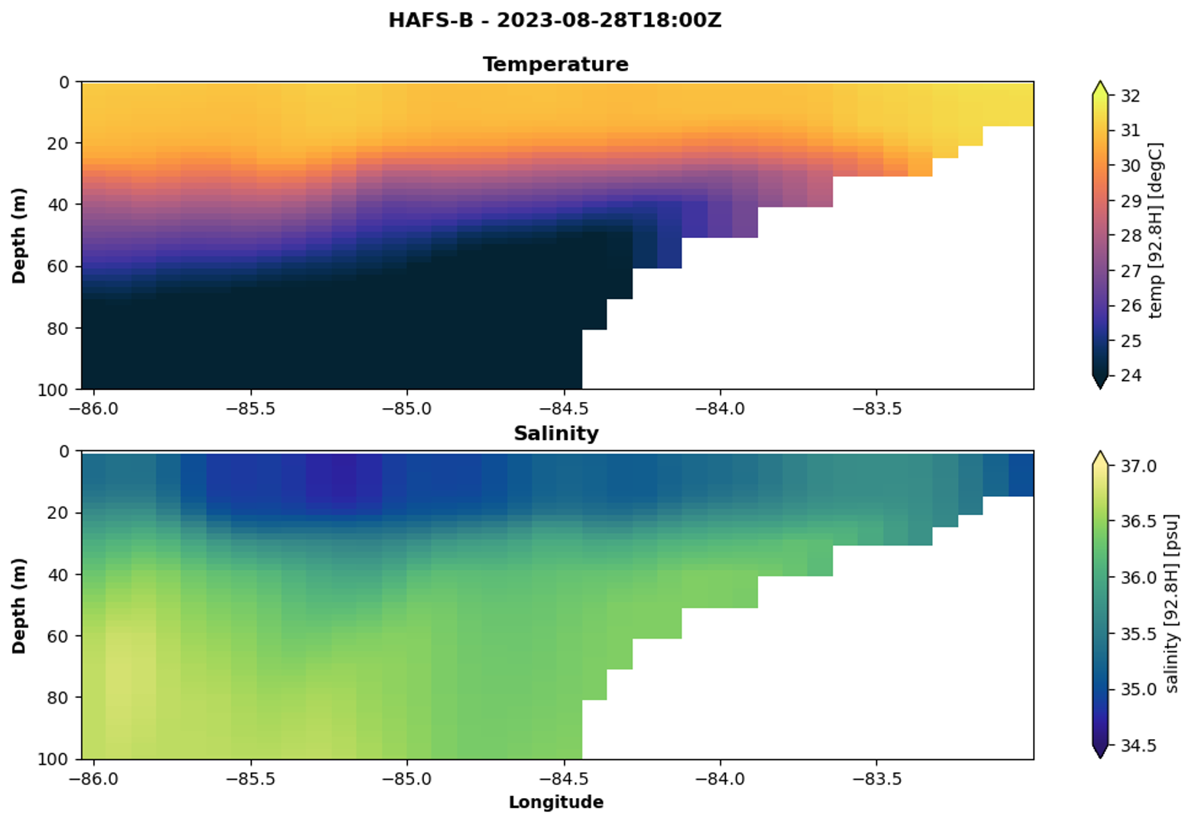
Hurricane Idalia -
Stage 3
Initial Conditions
Operational
Hurricane Analysis & Forecast System (HAFS)
T&S

Slide 14
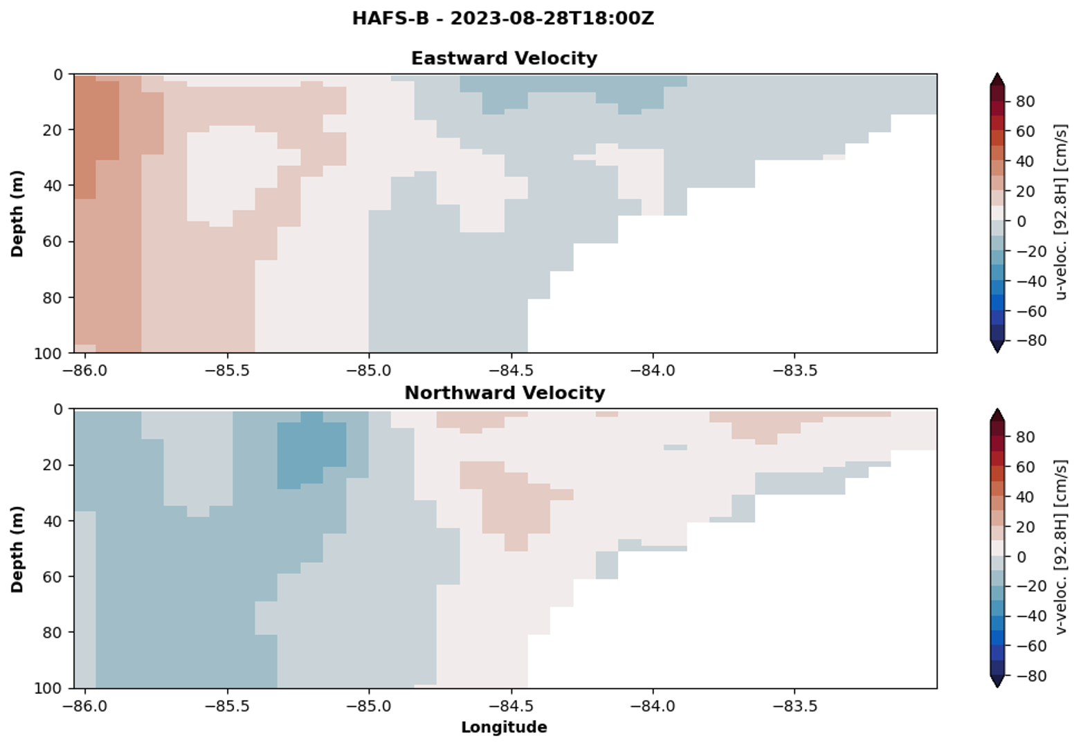
Hurricane Idalia -
Stage 3
Initial Conditions
Operational
Hurricane Analysis & Forecast System (HAFS)
U (+ to East) & V (+ to North)

Slide 15
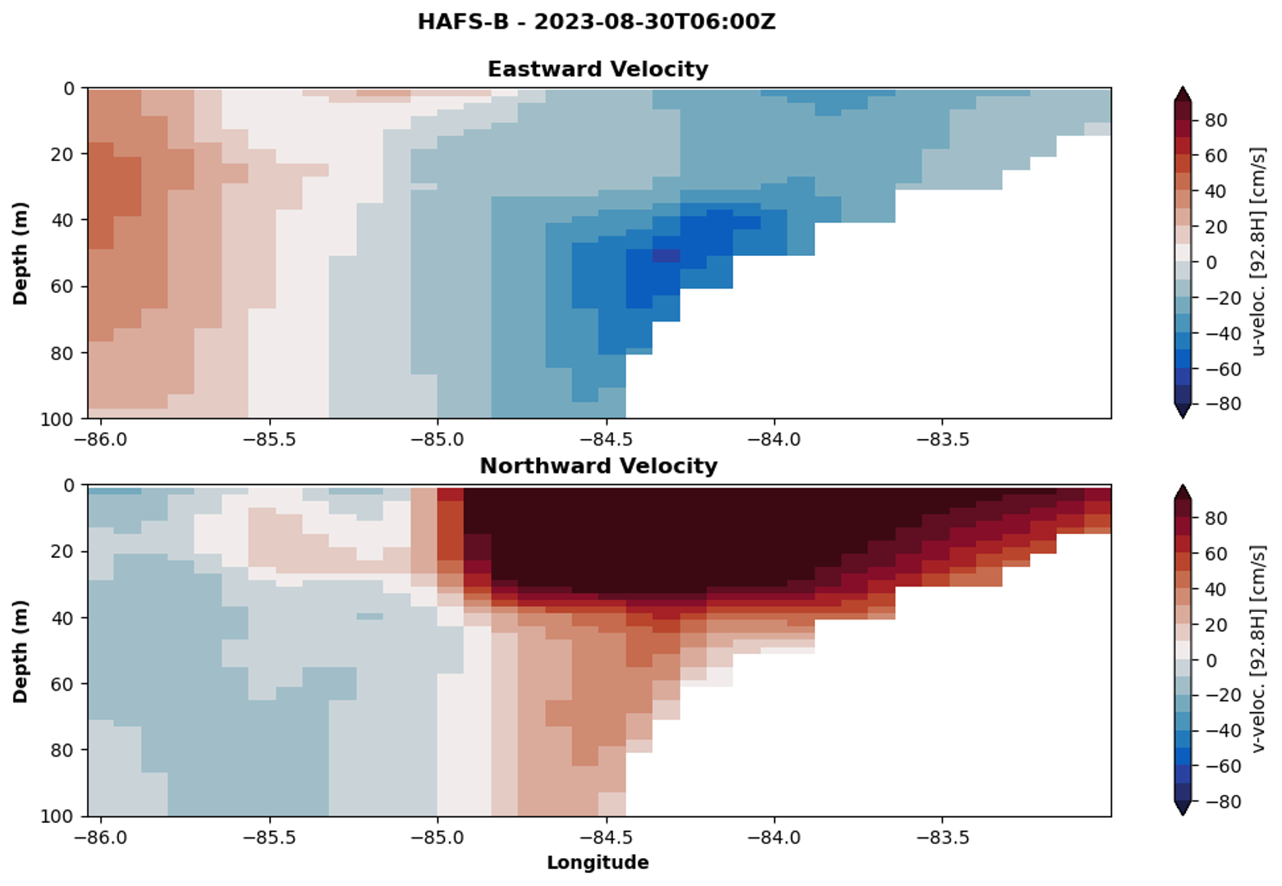
Hurricane Idalia -
Stage 3 Downwelling Response
Operational
Hurricane Analysis & Forecast System (HAFS)
U (+ to East) & V (+ to North)

Slide 16
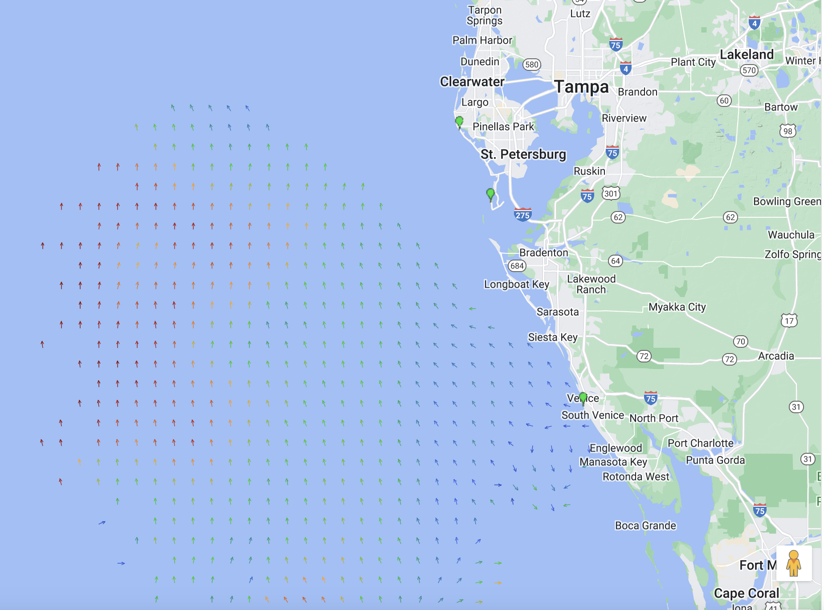
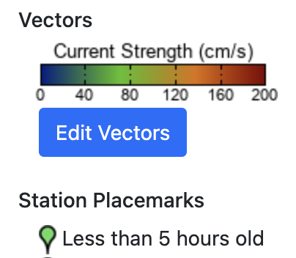
Hurricane Idalia -
Stage 3 Downwelling Response
Operational
Hurricane Analysis & Forecast System (HAFS)
U (+ to East) & V (+ to North)
>160 cm/s

Slide 17
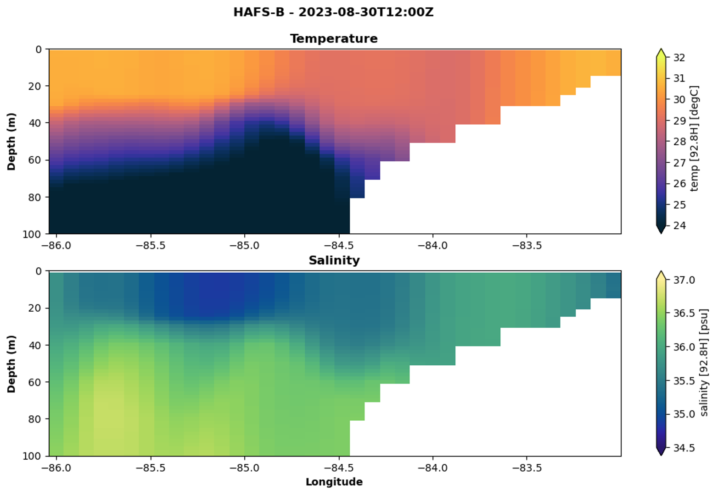
Hurricane Idalia -
Stage 3
Downwelling Response
Operational
Hurricane Analysis & Forecast System (HAFS)
T & S

Slide 18
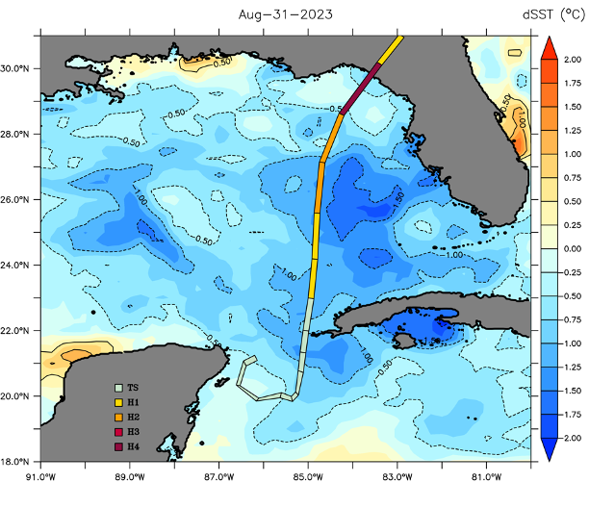
Hurricane Idalia -
Stage 3
Downwelling Response
Operational
Hurricane Analysis & Forecast System (HAFS)
T & S
1.0C-1.5C

Slide 19
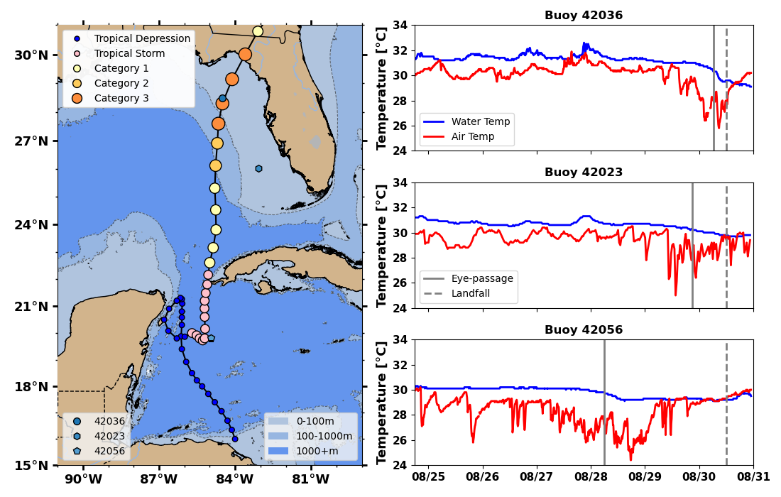
Hurricane Idalia - Stages 1-3
Water & Air Temperatures - NOAA NDBC Buoys
Water surface temperatures consistently warmer than the air temperatures along the entire track

Slide 20
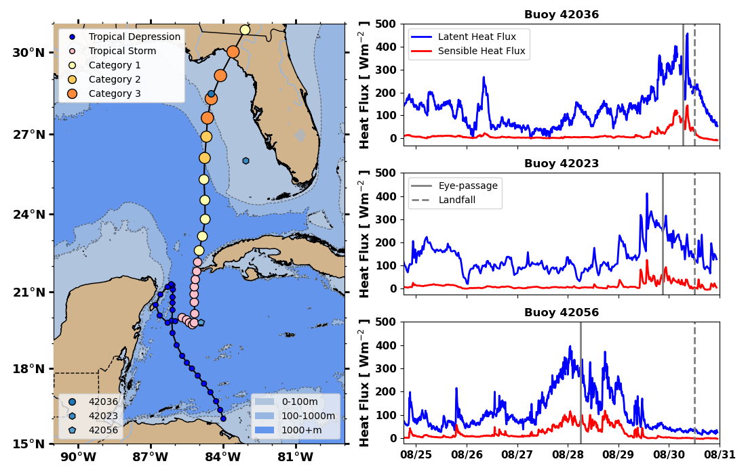
Hurricane Idalia - Stages 1-3
Latent & Sensible Heat Fluxes - NOAA NDBC Buoys
Latent & Sensible
Heat Fluxes large during the strong storm winds along the entire track
Fairall 1996 Bulk Parameterization https://agupubs.onlinelibrary.wiley.com/doi/10.1029/95JC03205

Slide 21
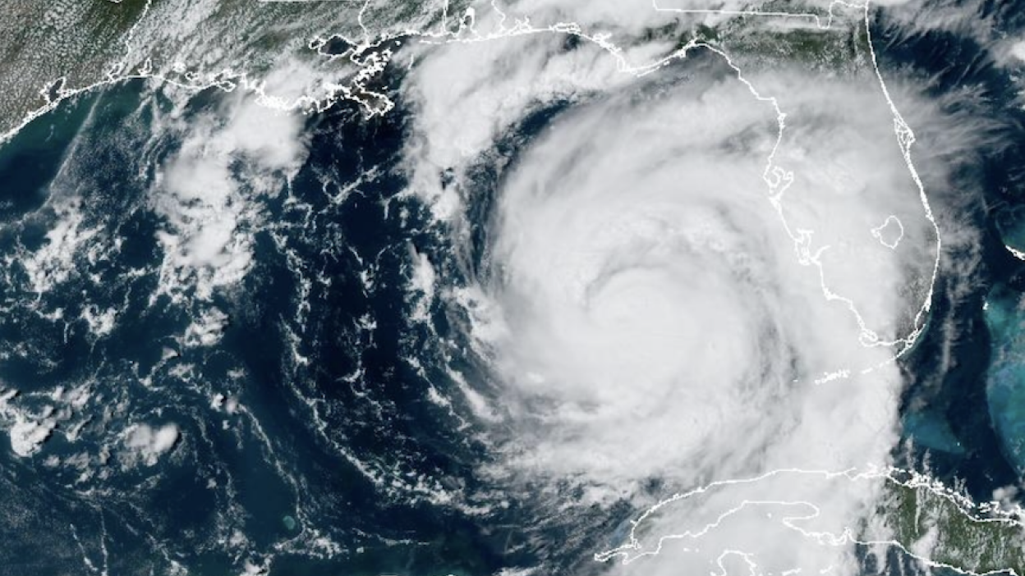
Idalia Conclusions:
Idalia was a fast moving storm that rapidly intensified along the West Florida Shelf.
Essential Ocean Features & Processes known to affect hurricane intensity were observed along the full track.
A diverse oceanographic dataset was assimilated by forecast models and is now available for process studies.

